Slide 1
Endesa Colombia
Our Distribution System In Front Of The Development Of Colombia

Slide 2
Agenda
Introduction
Background (The current situation in front of the development of the energy demand , current configuration outline and regulation requirements)
Plan of Action of Endesa Colombia (Approach on the development of the City-Region, reliability and quality service. Strategic focus to use of new technologies “Smart Grid”)
4. Experiences (Show some of the most important projects that had been made to guarantee the successfull of the Plan of Action . Examples EL DORADO INTERNATIONAL AIRPORT, ORION ….)
5. Conclusions
Our Distribution System in front of the development of Colombia
00

Slide 3
2. Background
The Present Situation
CUSTOMER
INFRASTRUCTURE
18.925 km Distribution network
898 Circuits
2.443.381 customers
Reliability and Quality Service
Timely attention to their needs
34.5 kV - 9% Network
REGULATION REQUIREMENTS
13.2 kV - 14% Network
11.4 kV - 77% Network
Currents Laws and Resolutions: Quality, Reliability and Security
CREG 043 2010 Resolution
15% Underground
85 %
overhead
Our Distribution System in front of the development of Colombia

Slide 4
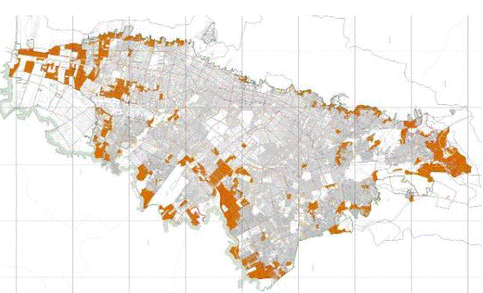
2. Background
Major Developments
North
Nelson Alonso
Guaymaral
Average rate of growth 2010-2016: 3,48%
Florida
Polígono USME
Terminal
Located between Tocancipá and Sesquilé
Located in Tocancipá
Major areas of development
Compartir
Connetion to NTS
SE HV/MV
Nva. Esperanza
02

Slide 5
3. Plan of Action
Infrastructure Progress
CUSTOMER
STRENGTHENING THE POWER SYSTEM AND GROWTH DISTRIBUTION SYSTEM
REGULATION
Law 143/94, CREG 025/95: Quality Security and Reliabity , Res. MME 18 2148 2007 y Res. CREG 097/08
CREG043
Resolution
INFRASTRUCTURE
IN Recloser
IN/OUT Recloser
Switches
New platform of communications
Automation Manoeuver Devices
Logic Operation and Automation
Remote Control Devices
2005
2011
2013
2015
Remote controlled Circuits
Our Distribution System in front of the development of Colombia

Slide 6
3. Plan of Action
Infrastructure Progress
CUSTOMER
STRENGTHENING THE POWER SYSTEM AND GROWTH DISTRIBUTION SYSTEM
REGULATION
Law 143/94, CREG 025/95: Quality Security and Reliabity , Res. MME 18 2148 2007 y Res. CREG 097/08
CREG043
Resolution
INFRASTRUCTURE
IN Recloser
IN/OUT Recloser
Switches
New platform of communications
Automation Manoeuver Devices
Logic Operation and Automation
Remote Control Devices
2005
2011
2013
2015
Remote controlled Circuits
Our Distribution System in front of the development of Colombia

Slide 7
Infrastructure Progress
2005 - 2011
Outline with Remote Control Devices
1
Circuit 1
I
R
SWITCH – LINK TO OPERATE WITH- OUT LOAD
I
R
Overhead
Circuit 2
1
2 Hours –The Average Time for Detection and Isolation Fault
I
Fault in 1
Open the main breaker of the substation. The recloser and the switches must be opened manually
Underground
Our Distribution System in front of the development of Colombia

Slide 8
3. Plan of Action
Infrastructure Progress
CUSTOMER
STRENGTHENING THE POWER SYSTEM AND GROWTH DISTRIBUTION SYSTEM
REGULATION
Law 143/94, CREG 025/95: Quality Security and Reliabity , Res. MME 18 2148 2007 y Res. CREG 097/08
CREG043
Resolution
INFRASTRUCTURE
IN Recloser
IN/OUT Recloser
Switches
New platform of communications
Automation Manoeuver Devices
Logic Operation and Automatión
Remote Control Devices
2005
2011
2013
2015
Remote controlled Circuits
Our Distribution System in front of the development of Colombia

Slide 9
Infrastructure Progress
2011- 2013
Outline with Remote Control Circuits
CASE 1: CIRCUITS
WITH EXIST RC´S
RTU SE 1
SCADA/SAC
Fault in 1
Open the main breaker of the substation and then open the recloser 1 near of the place where the fault occured. Also the center control operator send the signal to close the Recloser that link two circuits
R
R
Operator GPRS
Link GPRS in
IEC 104
R
RECLOSER OR SWITCH THAT
SUPPLY OR A LINK BETWEEN TWO CIRCUITS
Server VPN
Net
Front End IEC 104
R
R
SCADA/SAC
I
Telecontrol plus
Activate Automation
overhead
RTU SE 2
Our Distribution System in front of the development of Colombia

Slide 10
Infrastructure Progress
2011- 2013
Outline with Remote Control Circuits
OUTLINE OF 1.5
Ring Main Unit (RMU) with fault indicator and remote control
Ring Main Unit with remote control
that link two circuits
1
2
Switch 1
Switch 2
Switch 3
I
X< 5 minutes -The Average Time for Detection and Isolation Fault (control center operator)
30% Improve Quality Services – Less Affected customers
Fault in 2
Open the main breaker of the substation and then the switch with fault indicator sense the fault and send a signal to center control to given the order to open switch 2 and 3. these operation is done by a center control operator.
Fault in 1
Open the main breaker of the substation and then open the switch 1 in the RMU near of the place where the fault occured. Also the center control operator send the signal to close the RMU that link two circuits
Underground
Our Distribution System in front of the development of Colombia

Slide 11
3. Plan of Action
Infrastructure Progress
CUSTOMER
STRENGTHENING THE POWER SYSTEM AND GROWTH DISTRIBUTION SYSTEM
REGULATION
Law 143/94, CREG 025/95: Quality Security and Reliabity , Res. MME 18 2148 2007 y Res. CREG 097/08
CREG043
Resolution
INFRASTRUCTURE
IN Recloser
IN/OUT Recloser
Switches
New platform of communications
Automation Manoeuver Devices
Logic Operation and Automation
Remote Control Devices
2005
2011
2013
2015
Remote controlled Circuits
Our Distribution System in front of the development of Colombia

Slide 12
Infrastructure Progress
2013- 2015
Automation outline
overhead
RTU SE 1
GPRS Operator
R
R
VPN
Network Server
300A
200A
100A
pre fault Conditions , analysis and does the math for supply capacity
R
DISTRIBUTION AUTOMATION SYSTEM (SAD)
R
Send the order to isolate and re-establishment the area without fault.
Adjustment Group
Of protection
Send message to the SCADA system
SCADA/SAC
IEC 104
Fault in 1
200A
100A
Telecontrol Plus
Automation Activation
R
R
R
R
I
100A
RTU SE 2
Note: Automation Algorism begins after the cicle reclose on the main breaker and the recloser
Our Distribution System in front of the development of Colombia

Slide 13
Infrastructure Progress
2013- 2015
Outline with Remote Control Circuits
DISTRIBUTION AUTOMATION SYSTEM (SAD)
OUTLINE OF 1.5
Ring Main Unit (RMU) with fault indicator and remote control
Ring Main Unit with remote control
that link two circuits
1
2
I
X < 1 Minute -The Average Time for Detection and Isolation Fault
Fault in 1
Open the main breaker of the substation and the Distribution Automation System send the signal to open the switch in the RMU near of the place where the fault occured.
Also the SAD send the signal to close the RMU that link two circuits
Fault in 2
Open the main breaker of the substation and then the switch with fault indicator sense the fault and send a signal to center control to given the orden to open switch 2 and 3. these operation is done by the Distribution Automation System.
60% Improve Quality Services –less Affected customers
Underground
Underground
07
Our Distribution System in front of the development of Colombia

Slide 14
4. Experience
Pilot Projects
ORION
Enlargement and Remodeling of the El Dorado International Airport
Ciudad Verde
Our Distribution System in front of the development of Colombia

Slide 15
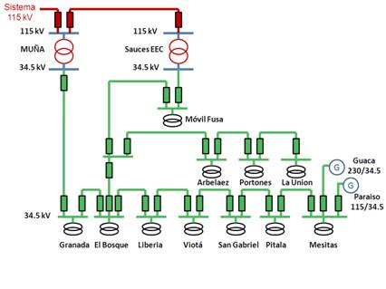
4. Experience
Pilot Projects
ORION
Outline close ring 34,5 kV fed by two high voltage substations (MUÑA & SAUCES)
Our Distribution System in front of the development of Colombia

Slide 16
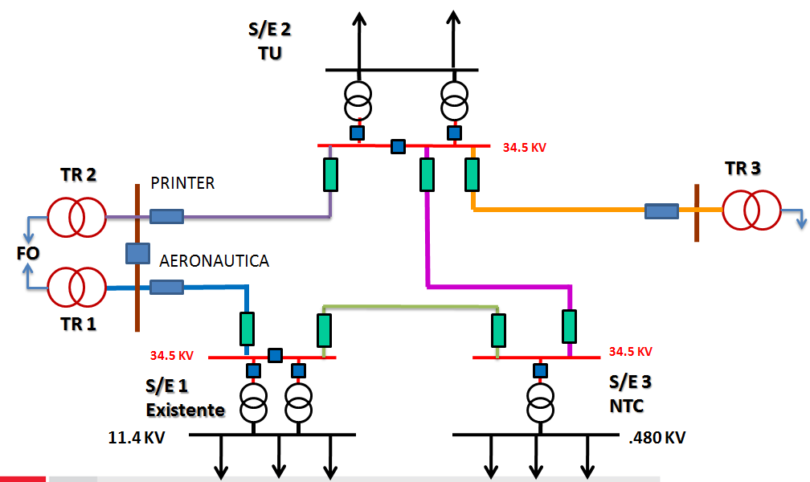
4. Experience
Pilot Projects
Enlargement and Remodeling of the El Dorado International Airport
Outline close ring 34,5 kV fed by two substations (FLORIDA & FONTIBÓN)
Our Distribution System in front of the development of Colombia

Slide 17
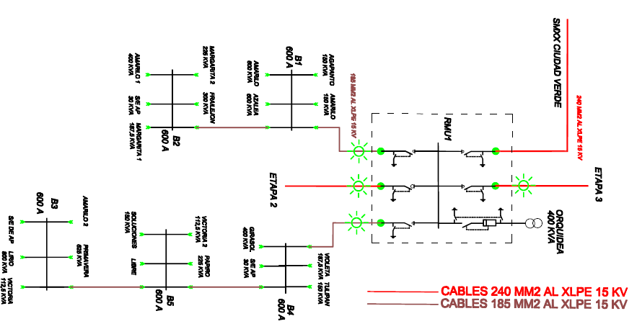
4. Experience
Pilot Projects
Ciudad Verde
Outline open ring 11,4 kV fed by two substations SAN MATEO & COMPARTIR. Using RMU and fault indicator with remote control.
11
Our Distribution System in front of the development of Colombia

Slide 18
5. Conclusions
CODENSA has been working to cover the energy demand growth of the CITY- REGION.
CODENSA turns its system of distribution in to an SMART SYSTEM (dynamic and timely).
CODENSA place the Distribution System to the service of a SMART COMUNITY that focuses on the development of the region and the COUNTRY.
Our Distribution System in front of the development of Colombia

Slide 19


